Slide 1
Integration of X/Twitter
in Teaching and Learning
Manu Gulati
Assistant Professor
SCERT, Delhi

Slide 2
Quick overview of today’s session
Objectives of the Session
Why X/Twitter ?
Need and Relevance of Using X/Twitter in the Teaching-Learning Ecosystem
Salient Features of X/Twitter
Hands-on Training
X/Twitter Etiquettes

Slide 3
Objectives of the session
To understand the crucial role of X in the educational landscape
To acquaint ourselves with the salient features of X
To familiarize ourselves in using X to learn-share-collaborate with other educators across globe

Slide 4
Why X/Twitter?
Unfolds news and information in real time
Helps one to connect with influential people/organisations
Has a large user-base across the globe

Slide 5
Why educators need to be professionally active on X/Twitter?
To cascade information; to create a ripple effect in teaching-learning scenario
To build a profound professional teacher community
To broaden visibility, reach and impact of what happens in classroom
To contribute in building powerful narratives
To use the platform as a virtual diary

Slide 6
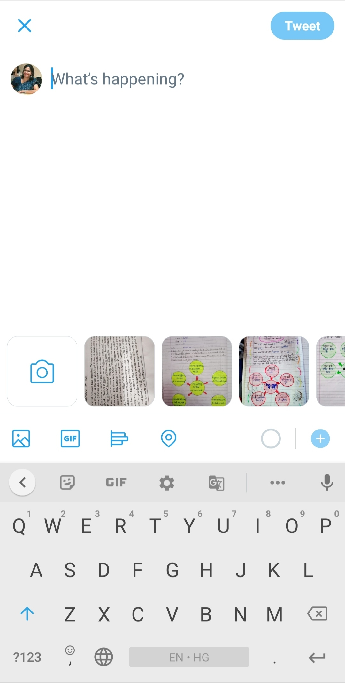
X/Twitter and its salient features
Brevity
Text in free accounts- Maximum 280 characters.
Photos- Maximum 4 pictures
Video- Maximum length
2 minutes 20 seconds

Slide 7
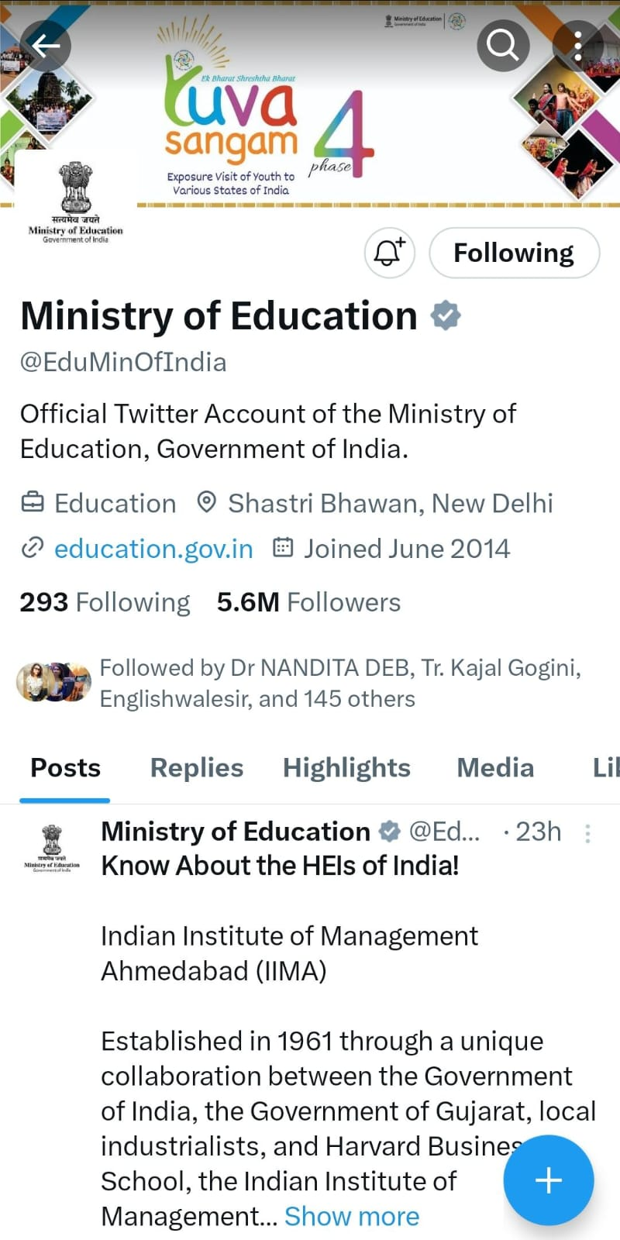
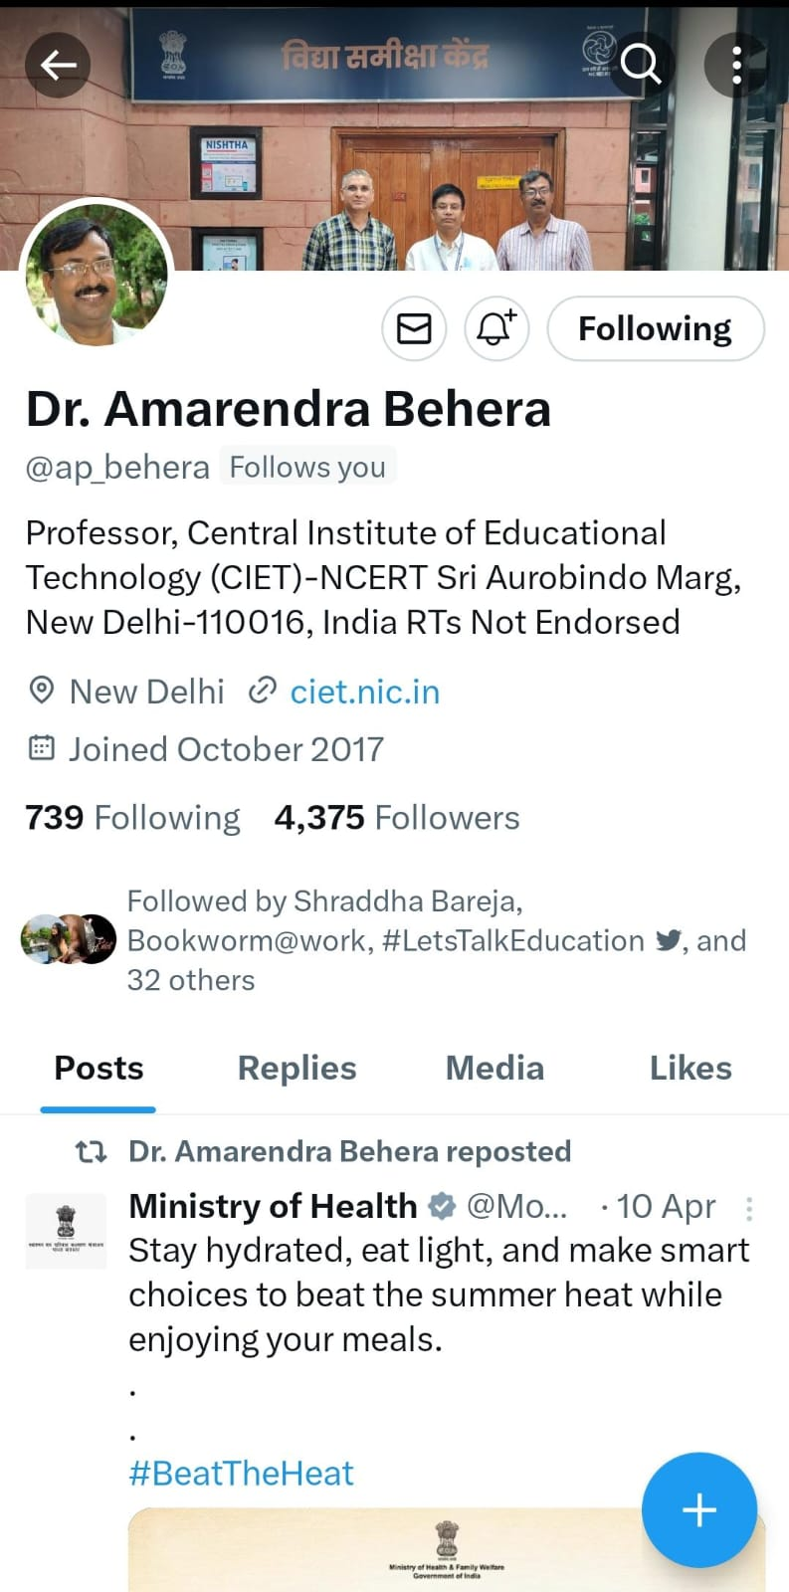
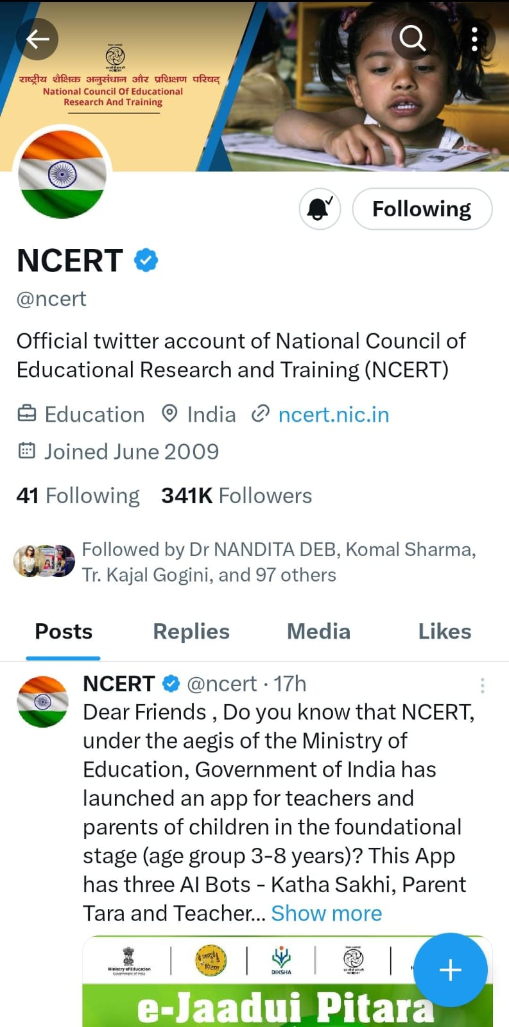
Profile, bio and handle name on X (Official)

Slide 8
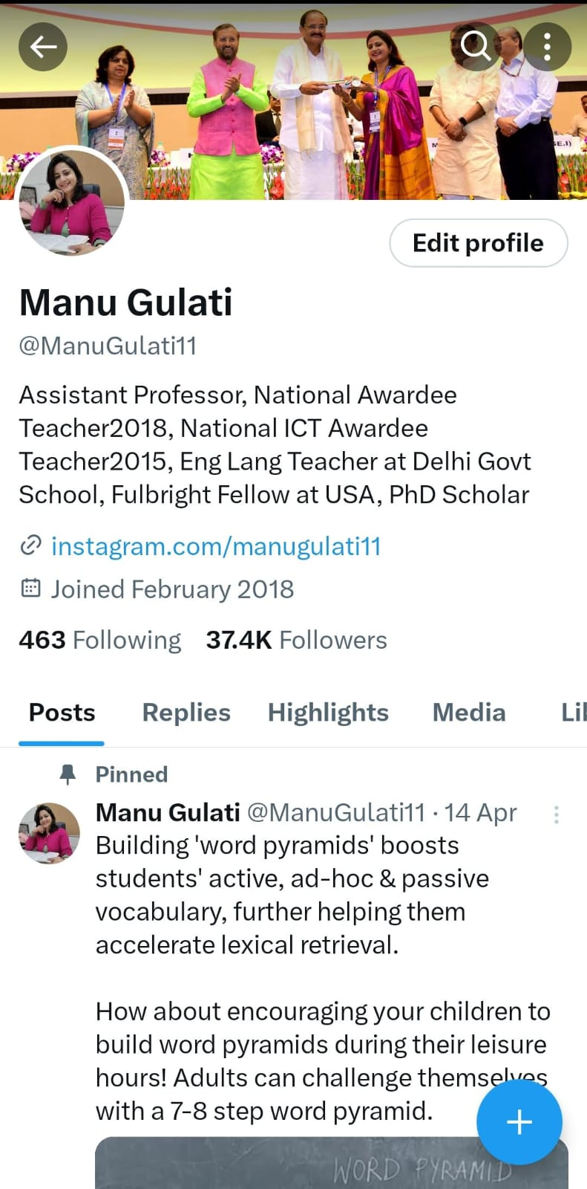
Profile, bio and handle name on X (Personal)

Slide 9
A few more features of X
Hashtags #
Hashtags are search engines
Help you in choosing content related to your interest area
Great way to organize conversations that are happening online.
#Education #Technology #Teachers

Slide 10
How to tag people on X/Twitter
Use of @
We tag people to bring our tweet to their notification
Tagging people/ organisations must be done mindfully
Too much of tagging in a single tweet is a sign of seeking unnecessary attention

Slide 11
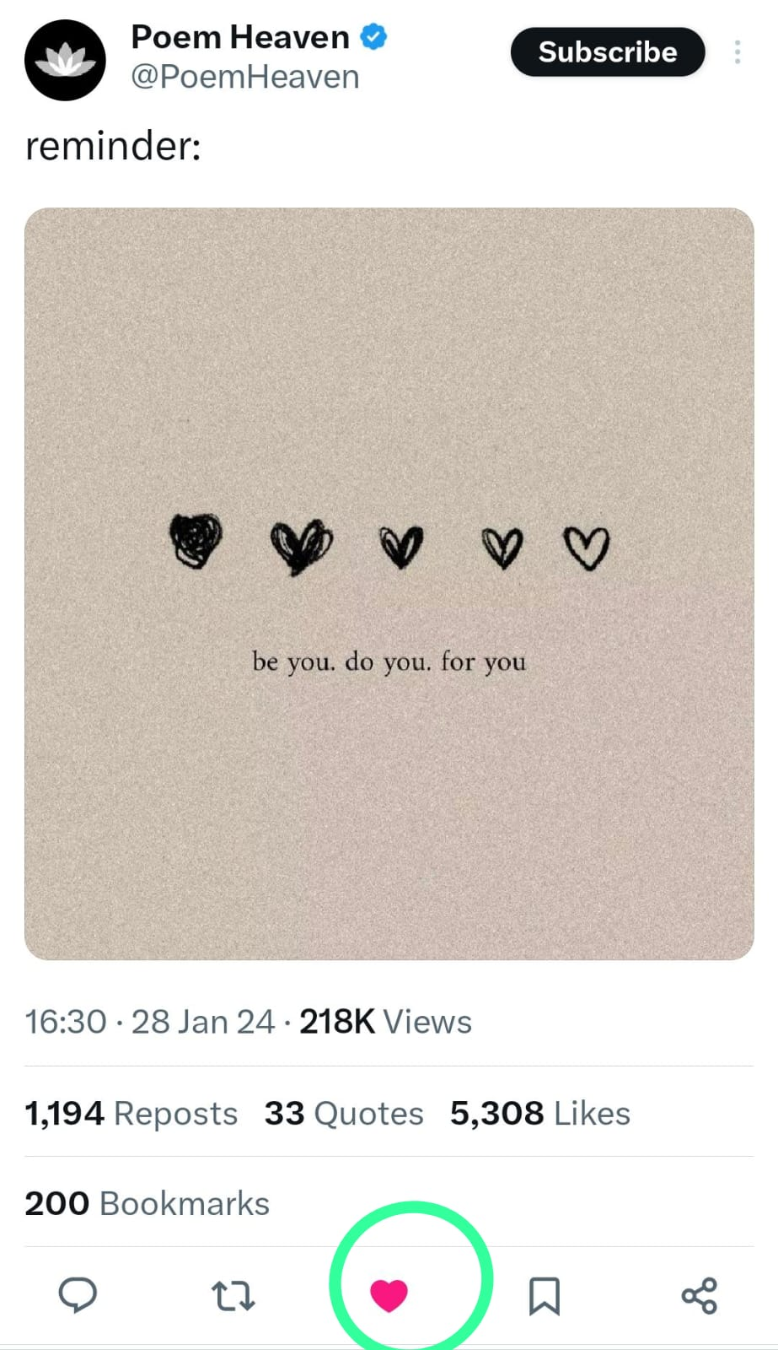
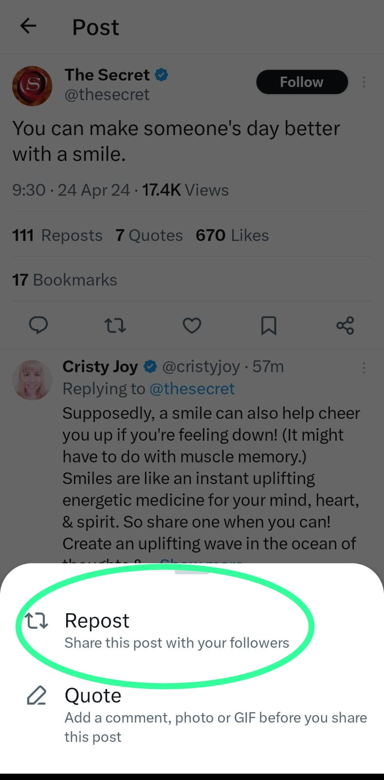
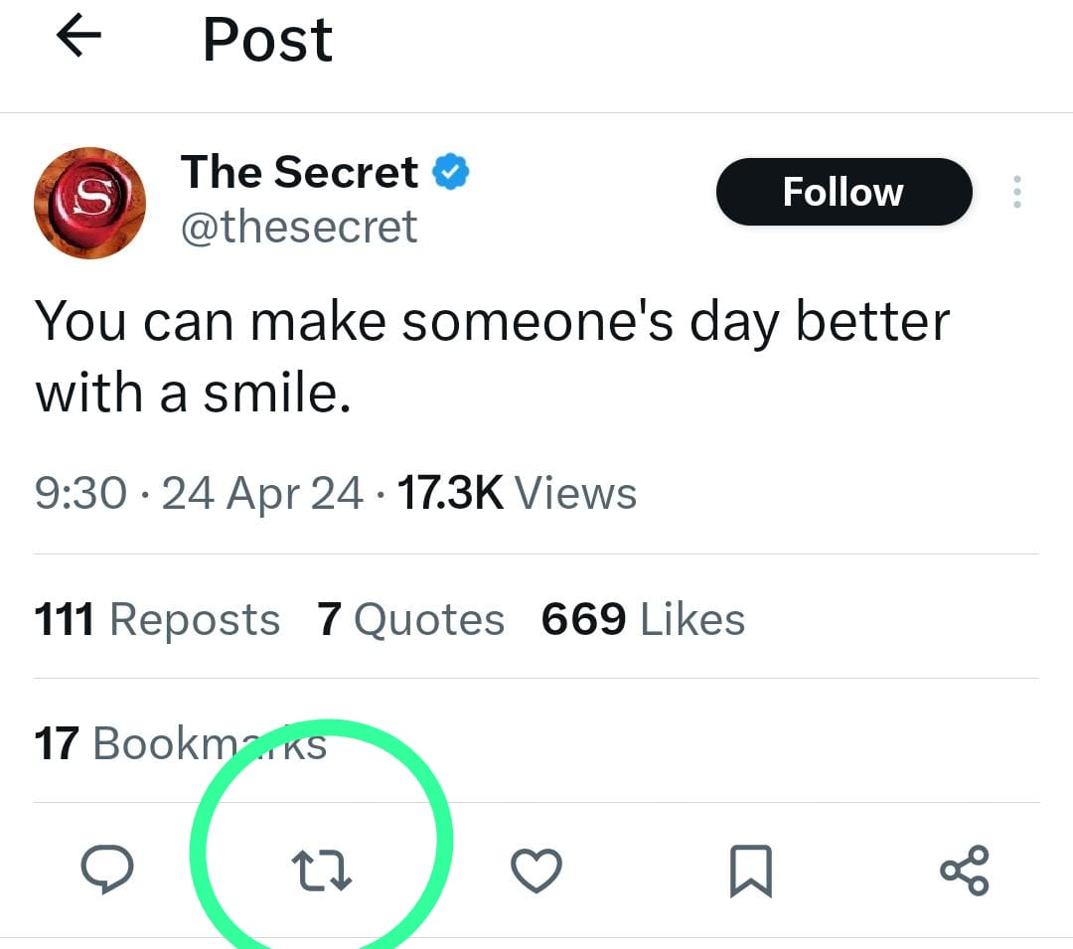
How to like or share any content on X/Twitter

Slide 12
Etiquettes to be followed on X
Be mindful of what you post!
Your social media posts reflect your being
Be kind and respectful to others
Do not abuse people
Set a positive discourse on X/Twitter

Slide 13
Stay safe on X/Twitter!
Do not accept/embrace any form of abuse on social media platform.
We have the option to block accounts or mute conversations on X. Make use of the option whenever needed.

Slide 14
Your Social Media Presence and Your Real Life
You are a wonderful being with immense capabilities to soar the high skies.
Never judge yourself on the basis of likes and followers on X or any other social media platform.

Slide 15
Get ready to Tweet about Today’s Session
Draft a message (today’s learning/concerns/expectations/feedback).
You may tag @ciet_ncert, @ManuGulati11
You may use #SocialMedia #Technology #Education
You may attach relevant pictures or video and then post your tweet.

Slide 16
Thank you so much for your active participation in today’s session.
Keep smiling, happy tweeting!
Manu Gulati
Assistant Professor
SCERT, Delhi

